Slide 1
Big Learning with Graph Computation
Joseph Gonzalez
jegonzal@cs.cmu.edu
Download the talk: http://tinyurl.com/7tojdmw
http://www.cs.cmu.edu/~jegonzal/talks/biglearning_with_graphs.pptx

Slide 2




Big Data already Happened
750 Million
Facebook Users
1 Billion Tweets
Per Week
6 Billion
Flickr Photos
48 Hours of Video
Uploaded every Minute

Slide 3
How do we understand and use Big Data?
Big Learning

Slide 4
Big Learning Today: Regression
Simple Models
Pros:
Easy to understand/predictable
Easy to train in parallel
Supports Feature Engineering
Versatile: classification, ranking, density estimation
Philosophy of Big Data and Simple Models

Slide 5
“Invariably, simple models and a lot of data trump more elaborate models based on less data.”
Alon Halevy, Peter Norvig, and Fernando Pereira, Google
http://static.googleusercontent.com/external_content/untrusted_dlcp/research.google.com/en//pubs/archive/35179.pdf

Slide 6
“Invariably, simple models and a lot of data trump more elaborate models based on less data.”
Alon Halevy, Peter Norvig, and Fernando Pereira, Google
http://static.googleusercontent.com/external_content/untrusted_dlcp/research.google.com/en//pubs/archive/35179.pdf

Slide 7
Why not build elaborate models with lots of data?
Difficult
Computationally
Intensive

Slide 8
Big Learning Today: Simple Models
Pros:
Easy to understand/predictable
Easy to train in parallel
Supports Feature Engineering
Versatile: classification, ranking, density estimation
Cons:
Favors bias in the presence of Big Data
Strong independence assumptions

Slide 9

Social Network
Cameras
Cooking
Shopper 1
Shopper 2

Slide 10
Big Data exposes the opportunity for structured machine learning

Slide 11
Examples

Slide 12
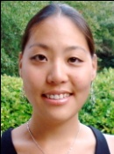


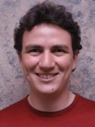
Label Propagation
Social Arithmetic:
Recurrence Algorithm:
iterate until convergence
Parallelism:
Compute all Likes[i] in parallel
Sue Ann
50% What I list on my profile
40% Sue Ann Likes
10% Carlos Like
80% Cameras
20% Biking
+
40%
I Like:
60% Cameras, 40% Biking
Profile
50%
50% Cameras
50% Biking
Me
Carlos
10%
30% Cameras
70% Biking
http://www.cs.cmu.edu/~zhuxj/pub/CMU-CALD-02-107.pdf

Slide 13
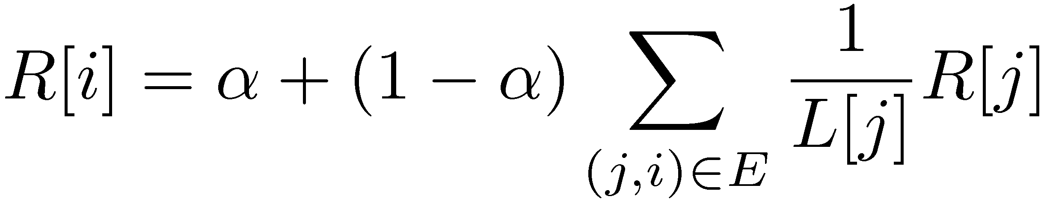
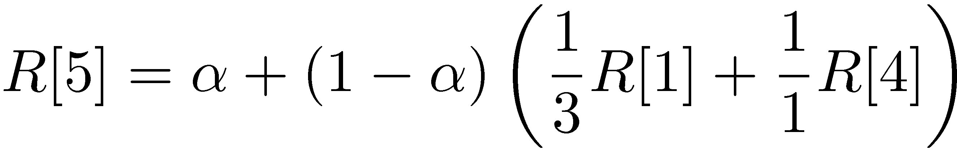
PageRank (Centrality Measures)
Iterate:
Where:
α is the random reset probability
L[j] is the number of links on page j
1
2
3
4
5
6
http://ilpubs.stanford.edu:8090/422/1/1999-66.pdf

Slide 14
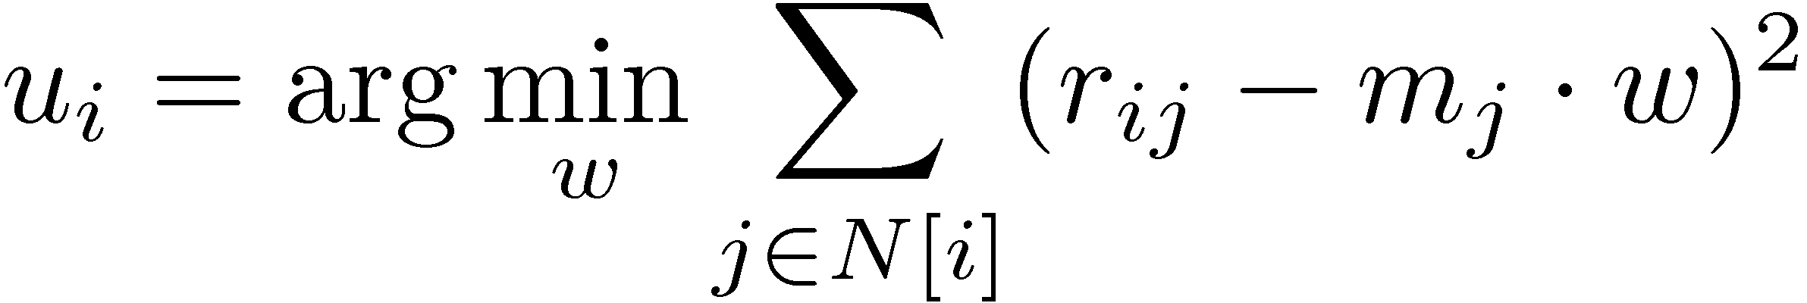
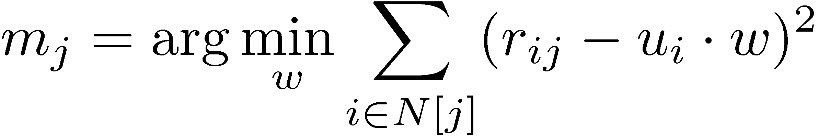
Matrix Factorization Alternating Least Squares (ALS)
m₁
r₁₁
Movies
u₁
Netflix
≈
x
Users
Users
m_{j}
r₁₂
m₂
User Factors (U)
r₂₃
Movie Factors (M)
u_{i}
u₂
r₂₄
m₃
Movies
Update Function computes:
http://dl.acm.org/citation.cfm?id=1424269

Slide 15
Other Examples
Statistical Inference in Relational Models
Belief Propagation
Gibbs Sampling
Network Analysis
Centrality Measures
Triangle Counting
Natural Language Processing
CoEM
Topic Modeling

Slide 16



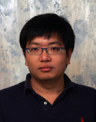
Graph Parallel Algorithms
Dependency
Graph
Local Updates
Iterative
Computation
My Interests
Friends Interests

Slide 17
What is the right tool for Graph-Parallel ML
Data-Parallel Graph-Parallel
Map Reduce
Map Reduce?
?
Feature
Extraction
Cross
Validation
Label Propagation
Lasso
Belief
Propagation
Kernel
Methods
Computing Sufficient
Statistics
Tensor
Factorization
PageRank
Deep Belief
Networks
Neural
Networks

Slide 18
Why not use Map-Reduce for Graph Parallel algorithms?

Slide 19
Data Dependencies are Difficult
Difficult to express dependent data in MR
Substantial data transformations
User managed graph structure
Costly data replication
Independent Data Records

Slide 20
Iterative Computation is Difficult
System is not optimized for iteration:
Iterations
Data
Data
Data
Data
CPU 1
CPU 1
CPU 1
Data
Data
Data
Data
Data
Data
Data
Data
CPU 2
CPU 2
CPU 2
Startup Penalty
Disk Penalty
Startup Penalty
Disk Penalty
Startup Penalty
Data
Data
Disk Penalty
Data
Data
Data
Data
Data
Data
CPU 3
CPU 3
CPU 3
Data
Data
Data
Data
Data
Data
Data
Data

Slide 21
Map-Reduce for Data-Parallel ML
Excellent for large data-parallel tasks!
Data-Parallel Graph-Parallel
Map Reduce
MPI/Pthreads
Map Reduce?
Feature
Extraction
Cross
Validation
SVM
Lasso
Belief
Propagation
Kernel
Methods
Computing Sufficient
Statistics
Tensor
Factorization
PageRank
Deep Belief
Networks
Neural
Networks

Slide 22
Threads, Locks, & Messages
We could use ….
“low level parallel primitives”

Slide 23
Threads, Locks, and Messages
ML experts repeatedly solve the same parallel design challenges:
Implement and debug complex parallel system
Tune for a specific parallel platform
Six months later the conference paper contains:
“We implemented ______ in parallel.”
The resulting code:
is difficult to maintain
is difficult to extend
couples learning model to parallel implementation
Graduate students

Slide 24
Addressing Graph-Parallel ML
We need alternatives to Map-Reduce
Data-Parallel Graph-Parallel
Map Reduce
Pregel (BSP)
MPI/Pthreads
Feature
Extraction
Cross
Validation
SVM
Lasso
Belief
Propagation
Kernel
Methods
Computing Sufficient
Statistics
Tensor
Factorization
PageRank
Deep Belief
Networks
Neural
Networks

Slide 25
Pregel: Bulk Synchronous Parallel
Compute
Communicate
Barrier
http://dl.acm.org/citation.cfm?id=1807184

Slide 26
Open Source Implementations
Giraph: http://incubator.apache.org/giraph/
Golden Orb: http://goldenorbos.org/
An asynchronous variant:
GraphLab: http://graphlab.org/

Slide 27
PageRank in Giraph (Pregel)
public void compute(Iterator<DoubleWritable> msgIterator) {
double sum = 0;
while (msgIterator.hasNext())
sum += msgIterator.next().get();
DoubleWritable vertexValue =
new DoubleWritable(0.15 + 0.85 * sum);
setVertexValue(vertexValue);
if (getSuperstep() < getConf().getInt(MAX_STEPS, -1)) {
long edges = getOutEdgeMap().size();
sentMsgToAllEdges(
new DoubleWritable(getVertexValue().get() / edges));
} else voteToHalt();
}
Sum PageRank over incoming messages
http://incubator.apache.org/giraph/

Slide 28
Tradeoffs of the BSP Model
Pros:
Graph Parallel
Relatively easy to implement and reason about
Deterministic execution

Slide 29
Embarrassingly Parallel Phases
Compute
Communicate
Barrier
http://dl.acm.org/citation.cfm?id=1807184

Slide 30
Tradeoffs of the BSP Model
Pros:
Graph Parallel
Relatively easy to build
Deterministic execution
Cons:
Doesn’t exploit the graph structure
Can lead to inefficient systems

Slide 31
Curse of the Slow Job
Iterations
Data
Data
Data
Data
CPU 1
CPU 1
CPU 1
Data
Data
Data
Data
Data
Data
Data
Data
CPU 2
CPU 2
CPU 2
Data
Data
Data
Data
Data
Data
Data
Data
CPU 3
CPU 3
CPU 3
Data
Data
Data
Data
Data
Data
Data
Data
Barrier
Barrier
Barrier
http://www.www2011india.com/proceeding/proceedings/p607.pdf

Slide 32
Curse of the Slow Job
Assuming runtime is drawn from an exponential distribution with mean 1.
http://www.www2011india.com/proceeding/proceedings/p607.pdf

Slide 33
Tradeoffs of the BSP Model
Pros:
Graph Parallel
Relatively easy to build
Deterministic execution
Cons:
Doesn’t exploit the graph structure
Can lead to inefficient systems
Can lead to inefficient computation

Slide 34
Example: Loopy Belief Propagation (Loopy BP)
Iteratively estimate the “beliefs” about vertices
Read in messages
Updates marginal estimate (belief)
Send updated out messages
Repeat for all variables until convergence
http://www.merl.com/papers/docs/TR2001-22.pdf

Slide 35

Bulk Synchronous Loopy BP
Often considered embarrassingly parallel
Associate processor with each vertex
Receive all messages
Update all beliefs
Send all messages
Proposed by:
Brunton et al. CRV’06
Mendiburu et al. GECC’07
Kang,et al. LDMTA’10
…

Slide 36
Sequential Computational Structure

Slide 37
Hidden Sequential Structure

Slide 38
Hidden Sequential Structure
Evidence
Evidence
Running Time:
Time for a single
parallel iteration
Number of Iterations

Slide 39
Optimal Sequential Algorithm
Running
Time
Bulk Synchronous
2n²/p
Gap
p ≤ 2n
Forward-Backward
2n
p = 1
Optimal Parallel
n
p = 2

Slide 40
The Splash Operation
Generalize the optimal chain algorithm: to arbitrary cyclic graphs:
~
Grow a BFS Spanning tree with fixed size
Forward Pass computing all messages at each vertex
Backward Pass computing all messages at each vertex
http://www.select.cs.cmu.edu/publications/paperdir/aistats2009-gonzalez-low-guestrin.pdf

Slide 41
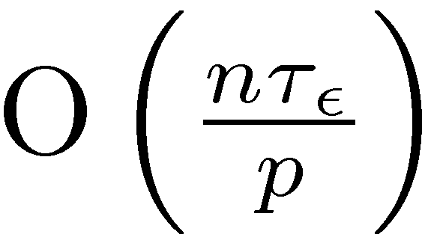
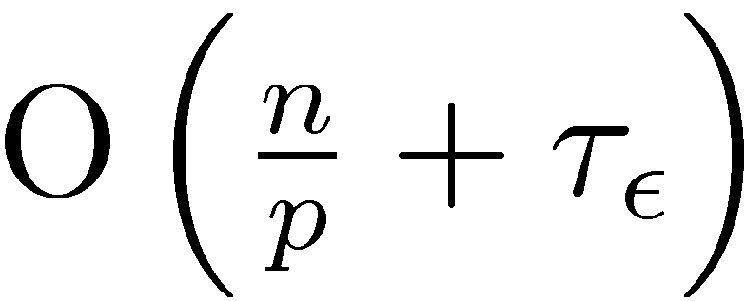
BSP is Provably Inefficient
Bulk Synchronous (Pregel)
Asynchronous Splash BP
Limitations of bulk synchronous model can lead to provably inefficient parallel algorithms
Gap
BSP
Splash BP

Slide 42
Tradeoffs of the BSP Model
Pros:
Graph Parallel
Relatively easy to build
Deterministic execution
Cons:
Doesn’t exploit the graph structure
Can lead to inefficient systems
Can lead to inefficient computation
Can lead to invalid computation

Slide 43
The problem with Bulk Synchronous Gibbs Sampling
t=1
t=2
t=3
Strong Positive
Correlation
t=0
Sequential
Execution
Strong Positive
Correlation
Strong Negative
Correlation
Parallel
Execution
Adjacent variables cannot be sampled simultaneously.

Slide 44

The Need for a New Abstraction
If not Pregel, then what?
Data-Parallel Graph-Parallel
Map Reduce
Pregel (Giraph)
Feature
Extraction
Cross
Validation
Belief
Propagation
Kernel
Methods
SVM
Computing Sufficient
Statistics
Tensor
Factorization
PageRank
Neural
Networks
Lasso
Deep Belief
Networks

Slide 45
GraphLab Addresses the Limitations of the BSP Model
Use graph structure
Automatically manage the movement of data
Focus on Asynchrony
Computation runs as resources become available
Use the most recent information
Support Adaptive/Intelligent Scheduling
Focus computation to where it is needed
Preserve Serializability
Provide the illusion of a sequential execution
Eliminate “race-conditions”

Slide 46
What is GraphLab?
http://graphlab.org/ Checkout Version 2

Slide 47
The GraphLab Framework
Graph Based
Data Representation
Update Functions
User Computation
Scheduler
Consistency Model

Slide 48
Data Graph
A graph with arbitrary data (C++ Objects) associated with each vertex and edge.
Graph:
Social Network
Vertex Data:
User profile text
Current interests estimates
Edge Data:
Similarity weights

Slide 49
Implementing the Data Graph
All data and structure is stored in memory
Supports fast random lookup needed for dynamic computation
Multicore Setting:
Challenge: Fast lookup, low overhead
Solution: dense data-structures
Distributed Setting:
Challenge: Graph partitioning
Solutions: ParMETIS and Random placement

Slide 50
New Perspective on Partitioning
Natural graphs have poor edge separators
Classic graph partitioning tools (e.g., ParMetis, Zoltan …) fail
Natural graphs have good vertex separators
CPU 1
CPU 2
Must synchronize
many edges
Y
Y
CPU 1
CPU 2
Y
Must synchronize a single vertex
Y

Slide 51
Update Functions
An update function is a user defined program which when applied to a vertex transforms the data in the scope of the vertex
pagerank(i, scope){
// Get Neighborhood data
(R[i], W_{ij}, R[j]) ←scope;
// Update the vertex data
// Reschedule Neighbors if needed
if R[i] changes then
reschedule_neighbors_of(i);
}

Slide 52
PageRank in GraphLab (V2)
struct pagerank : public iupdate_functor<graph, pagerank> {
void operator()(icontext_type& context) {
double sum = 0;
foreach ( edge_type edge, context.in_edges() )
sum += 1/context.num_out_edges(edge.source()) *
context.vertex_data(edge.source());
double& rank = context.vertex_data();
double old_rank = rank;
rank = RESET_PROB + (1-RESET_PROB) * sum;
double residual = abs(rank – old_rank)
if (residual > EPSILON)
context.reschedule_out_neighbors(pagerank());
}
};

Slide 53
PageRank Update Function
Directly Read
Neighbor Values
GraphLab_pagerank(scope) {
double sum = 0;
forall ( nbr in scope.in_neighbors() )
sum = sum + neighbor.value() / nbr.num_out_edges();
double old_rank = scope.vertex_data();
scope.center_value() = ALPHA + (1-ALPHA) * sum;
double residual = abs(scope.center_value() – old_rank);
if (residual > EPSILON)
reschedule_out_neighbors();
}
Dynamically Schedule
Computation

Slide 54
Dynamic Computation
Converged
Slowly Converging
Focus Effort

Slide 55
The Scheduler
The scheduler determines the order that vertices are updated
CPU 1
b
c
d
a
b
c
Scheduler
e
f
b
e
f
g
a
i
h
i
j
h
i
j
k
CPU 2
The process repeats until the scheduler is empty

Slide 56
Choosing a Schedule
The choice of schedule affects the correctness and parallel performance of the algorithm
GraphLab provides several different schedulers
Round Robin: vertices are updated in a fixed order
FIFO: Vertices are updated in the order they are added
Priority: Vertices are updated in priority order
Obtain different algorithms by simply changing a flag!
--scheduler=sweep
--scheduler=fifo
--scheduler=priority

Slide 57
The GraphLab Framework
Graph Based
Data Representation
Update Functions
User Computation
Scheduler
Consistency Model

Slide 58
Ensuring Race-Free Execution
How much can computation overlap?

Slide 59
GraphLab Ensures Sequential Consistency
For each parallel execution, there exists a sequential execution of update functions which produces the same result.
CPU 1
time
Parallel
CPU 2
Sequential
Single
CPU

Slide 60
Consistency Rules
Full Consistency
Data
Guaranteed sequential consistency for all update functions

Slide 61
Full Consistency
Full Consistency

Slide 62
Obtaining More Parallelism
Full Consistency
Edge Consistency

Slide 63
Edge Consistency
Edge Consistency
Safe
CPU 1
Read
CPU 2

Slide 64
Consistency Through Scheduling
Edge Consistency Model:
Two vertices can be Updated simultaneously if they do not share an edge.
Graph Coloring:
Two vertices can be assigned the same color if they do not share an edge.
Phase 1
Phase 2
Phase 3
Execute in Parallel
Synchronously
Barrier
Barrier
Barrier

Slide 65
Consistency Through R/W Locks
Read/Write locks:
Full Consistency
Edge Consistency
Write
Write
Write
Canonical Lock Ordering
Read
Write
Read
Read
Write

Slide 66
Consistency Through R/W Locks
Multicore Setting: Pthread R/W Locks
Distributed Setting: Distributed Locking
Prefetch Locks and Data
Allow computation to proceed while locks/data are requested.
Data Graph
Partition
Node 1
Node 2
Lock Pipeline

Slide 67
The GraphLab Framework
Graph Based
Data Representation
Update Functions
User Computation
Scheduler
Consistency Model

Slide 68
Alternating Least
Squares
SVD
Splash Sampler
CoEM
Bayesian Tensor
Factorization
Lasso
Belief Propagation
PageRank
LDA
SVM
Dynamic Block Gibbs Sampling
Linear Solvers
Matrix
Factorization
…Many others…
K-Means

Slide 69


















































Startups Using GraphLab
Companies experimenting (or downloading) with GraphLab
Academic projects exploring (or downloading) GraphLab
Notes:
Projects using GraphLab
GaBP:
USCS: Smoothing genomic sequences UCSB: Performance testing of linear solvers McGill: performance of linear solvers PMF:
Universities:
HKUST (Hong Kong University) - KDD CUP VU University Amsterdam: integrating TV into the web University of Lubliana: KDD CUP Heldia institute of technology: community detection in social networks University of Austin, Texas: KDD CUP University of the Aegean: KDD CUP University of Macedonia: KDD CUP University of South Florida: stock market predictions: https://sites.google.com/site/thesisonstockmining/home New Maxico State University (UMSC): KDD CUP Hasmukh Goswami College of Engineering, India: Sagar Soni - Collaborative filtering. Companies:
smarttypes.org: clustering social networks rummble.com: clustering social networks AT&T Labs: KDD CUP Facebook: recommendations Yahoo Research (Smola’s group) matrix factorization with side information for collaborative filtering.
Downloads also from: Google, MSR, IBM Research, Apple, NEC, Hitachi, Xerox, Nokia. Clustering:
http://www.nottingham.edu.my/index.aspx - building a recommender system using data from flickr UCLA - topic models like LDA and LSI NBP:
University of Waterloo Applications on top:
Cornell: community detection on networks Yahoo Research (Barcelona) : graph processing library MIT: create different kinds of parallel or distributed systems for the sampling algorithm running within probabilistic programming engines

Slide 70
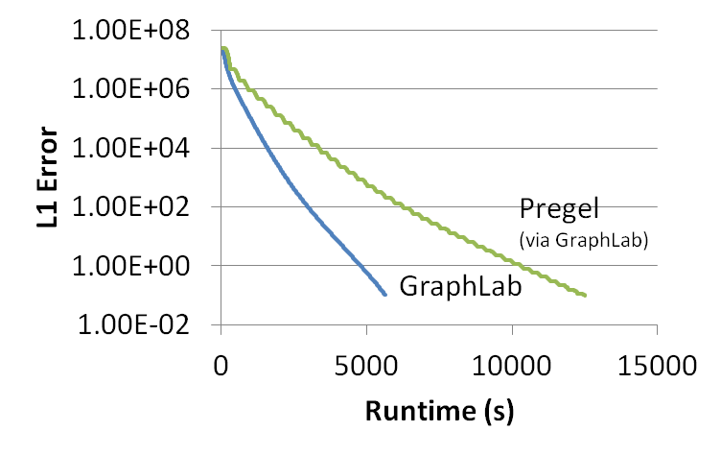
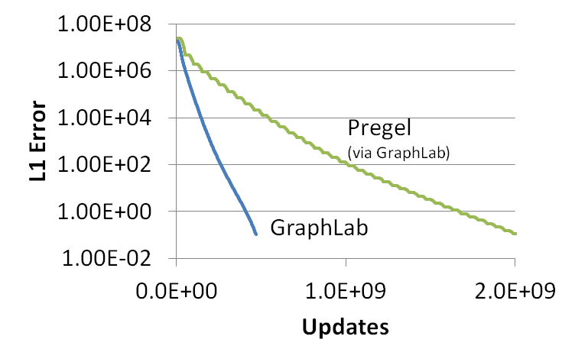
GraphLab vs. Pregel (BSP)
51% updated only once
PageRank (25M Vertices, 355M Edges)

Slide 71
CoEM (Rosie Jones, 2005)
Named Entity Recognition Task
the dog
<X> ran quickly
Is “Dog” an animal?
Is “Catalina” a place?
Australia
travelled to <X>
Vertices: 2 Million
Edges: 200 Million
Catalina Island
<X> is pleasant
Hadoop | 95 Cores | 7.5 hrs

Slide 72
CoEM (Rosie Jones, 2005)
Better
Optimal
Hadoop | 95 Cores | 7.5 hrs
GraphLab | 16 Cores | 30 min
GraphLab CoEM
6x fewer CPUs!
15x Faster!
72

Slide 73
CoEM (Rosie Jones, 2005)
Optimal
Better
Hadoop | 95 Cores | 7.5 hrs
GraphLab | 16 Cores | 30 min
Large
GraphLab in the Cloud | 32 EC2 machines | 80 secs
Small
0.3% of Hadoop time

Slide 74
The Cost of the Wrong Abstraction
Log-Scale!

Slide 75
Tradeoffs of GraphLab
Pros:
Separates algorithm from movement of data
Permits dynamic asynchronous scheduling
More expressive consistency model
Faster and more efficient runtime performance
Cons:
Non-deterministic execution
Defining “residual” can be tricky
Substantially more complicated to implement

Slide 76
Scalability and Fault-Tolerance in Graph Computation

Slide 77
Scalability
MapReduce: Data Parallel
Map heavy jobs scale VERY WELL
Reduce places some pressure on the networks
Typically Disk/Computation bound
Favors: Horizontal Scaling (i.e., Big Clusters)
Pregel/GraphLab: Graph Parallel
Iterative communication can be network intensive
Network latency/throughput become the bottleneck
Favors: Vertical Scaling (i.e., Faster networks and Stronger machines)

Slide 78
Cost-Time Tradeoff
a few machines helps a lot
faster
diminishing returns
more machines, higher cost
video co-segmentation results

Slide 79
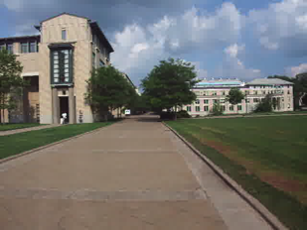
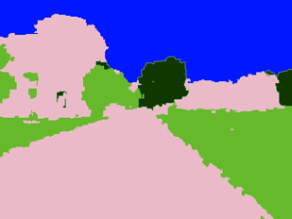
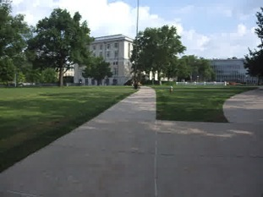
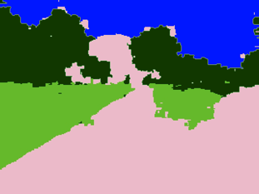
Video Cosegmentation
Segments mean the same
Gaussian EM clustering + BP on 3D grid
Model: 10.5 million nodes, 31 million edges
Video version of [Batra]

Slide 80
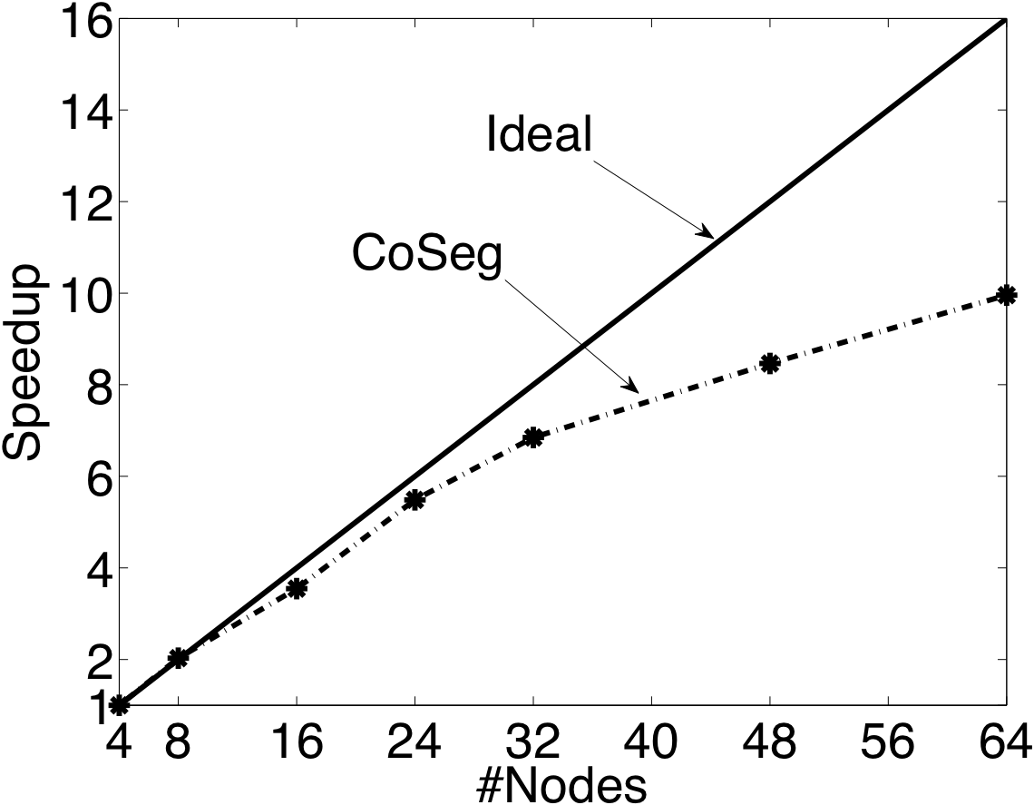
Video Coseg. Strong Scaling
Ideal
GraphLab

Slide 81
Video Coseg. Weak Scaling
GraphLab
Ideal

Slide 82
Fault Tolerance

Slide 83
Rely on Checkpoint
Pregel (BSP)
GraphLab
Compute
Communicate
Barrier
Checkpoint
Synchronous Checkpoint
Construction
Asynchronous Checkpoint
Construction

Slide 84
Checkpoint Interval
Checkpoint Interval:
T_{i}
Re-compute
Time
Checkpoint
Checkpoint Length:
T_{s}
Machine Failure
Tradeoff:
Short T_{i}: Checkpoints become too costly
Long T_{i} : Failures become too costly
Time
Checkpoint
Checkpoint
Checkpoint
Checkpoint
Checkpoint
Time
Checkpoint

Slide 85
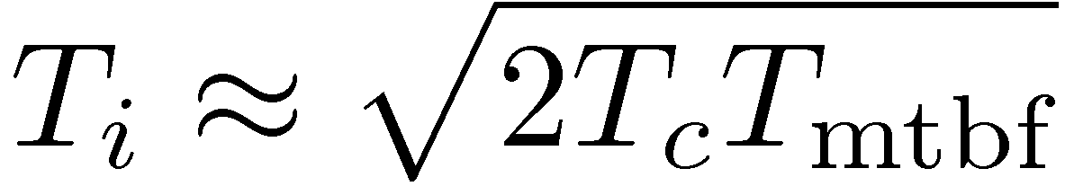
Optimal Checkpoint Intervals
Construct a first order approximation:
Example:
64 machines with a per machine MTBF of 1 year
T_{mtbf} = 1 year / 64 ≈ 130 Hours
T_{c} = of 4 minutes
T_{i} ≈ of 4 hours
Checkpoint Interval
Length of
Checkpoint
Mean time
between failures
From: http://dl.acm.org/citation.cfm?id=361115
Notes:
Correction: Added missing multiple of 2.

Slide 86
Open Challenges

Slide 87
Dynamically Changing Graphs
Example: Social Networks
New users → New Vertices
New Friends → New Edges
How do you adaptively maintain computation:
Trigger computation with changes in the graph
Update “interest estimates” only where needed
Exploit asynchrony
Preserve consistency

Slide 88
Graph Partitioning
How can you quickly place a large data-graph in a distributed environment:
Edge separators fail on large power-law graphs
Social networks, Recommender Systems, NLP
Constructing vertex separators at scale:
No large-scale tools!
How can you adapt the placement in changing graphs?

Slide 89
Graph Simplification for Computation
Can you construct a “sub-graph” that can be used as a proxy for graph computation?
See Paper:
Filtering: a method for solving graph problems in MapReduce.
http://research.google.com/pubs/pub37240.html

Slide 90
Concluding BIG Ideas
Modeling Trend: Independent Data → Dependent Data
Extract more signal from noisy structured data
Graphs model data dependencies
Captures locality and communication patterns
Data-Parallel tools not well suited to Graph Parallel problems
Compared several Graph Parallel Tools:
Pregel / BSP Models:
Easy to Build, Deterministic
Suffers from several key inefficiencies
GraphLab:
Fast, efficient, and expressive
Introduces non-determinism
Scaling and Fault Tolerance:
Network bottlenecks and Optimal Checkpoint intervals
Open Challenges: Enormous Industrial Interest

Slide 91
